Slide 1
Kickstart Café Recycling
A Frisco ISD Guide

Slide 2
What Goes Where?
Trash
Food
Straws
Utensils
Napkins
Pouches (CapriSun)
Yogurt tubes
Condiment packets
Styrofoam
Dirty/Greasy containers
Recycle
Drink containers
Lunchables boxes
Ziplock bags
Microwave boxes
Yogurt containers
Cans
Plastic tubs/bowls
Plastic containers from lunchline
Clean paper boats
Liquids
From drink containers
Syrup from fruit cups
NO food
NO straws
NO solids

Slide 3
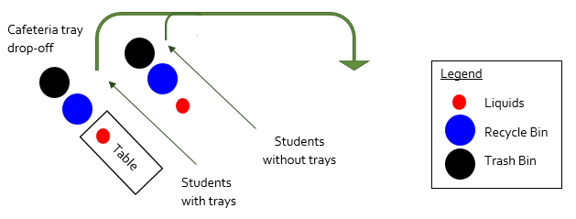
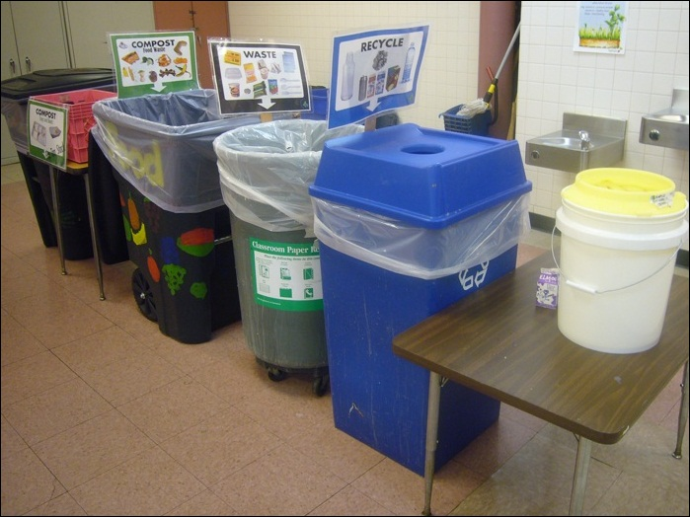
Waste in the Right Place

Slide 4
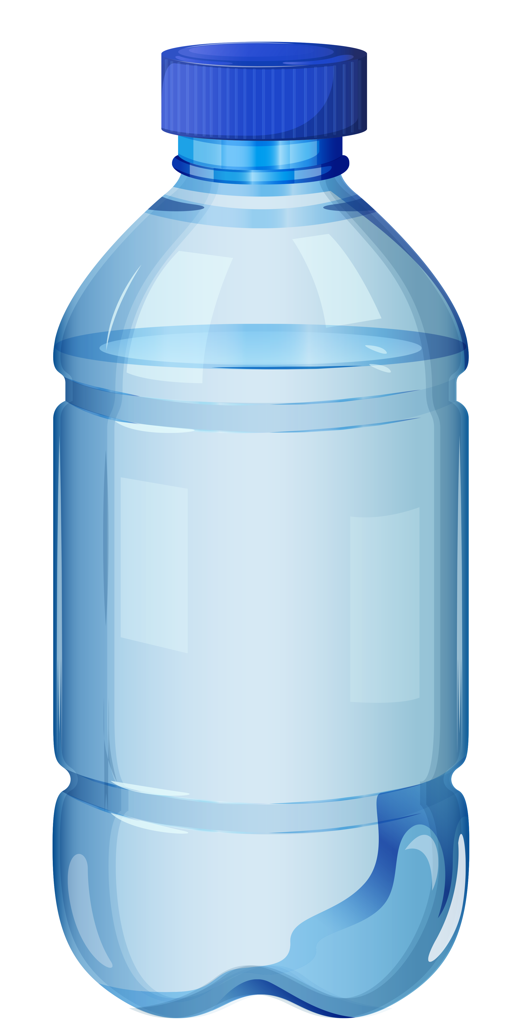
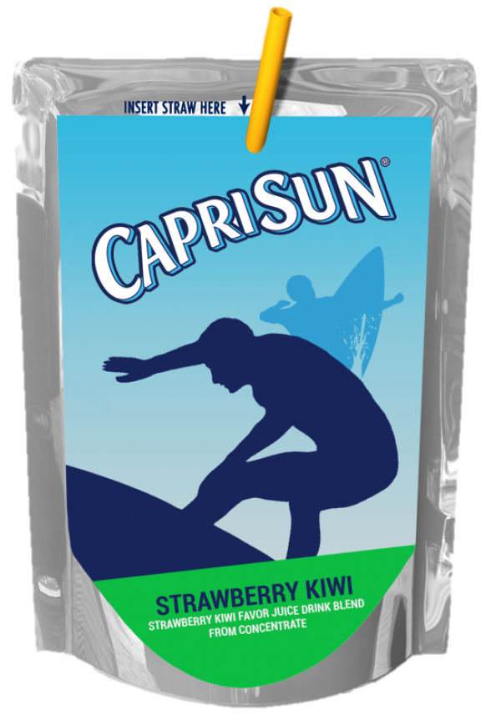
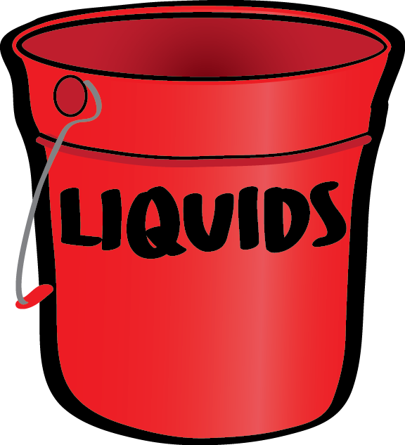
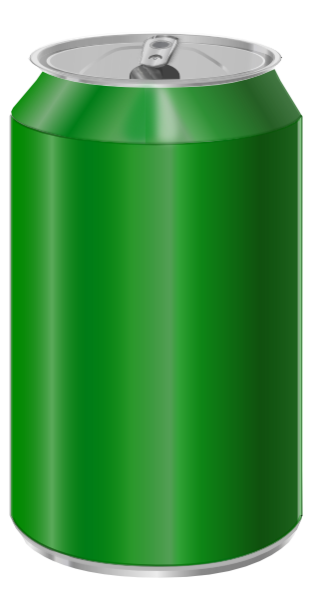
Day 1: Drink Containers
Recycle | Trash | Dump
Milk cartons, juice boxes, plastic bottles, glass bottles, beverage cans | Pouches (capri sun), straws | Liquids

Slide 5
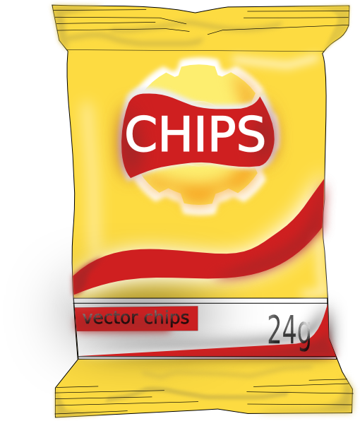
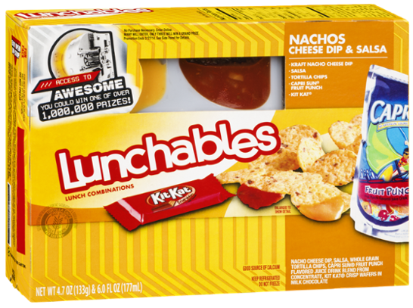
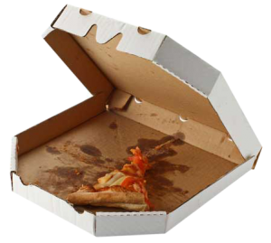
Day 2: Boxes and bags
Recycle | Trash | Dump
Lunchables boxes and trays, ziplock bags, plastic bags, and microwave lunch boxes | Greasy/ soiled boxes (pizza), chip/cookie bags, and food | liquids

Slide 6
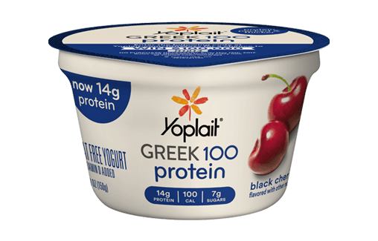
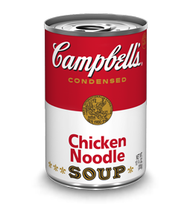
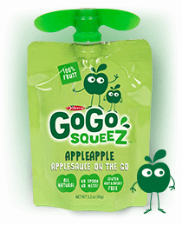
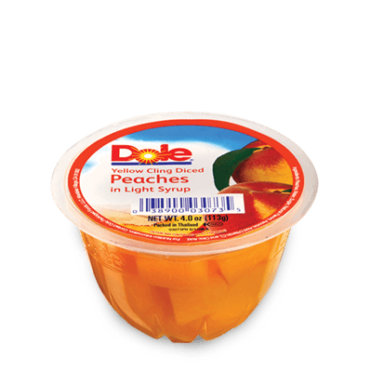
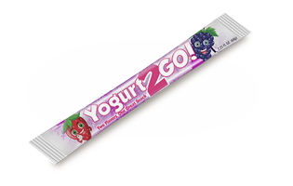
Day 3: Bowls and Tubs
Recycle | Trash | Dump
Rigid yogurt containers, soup cans/ bowls, fruit cans/bowls | Food, yogurt tubes, fruit pouches | Liquids NO yogurt

Slide 7
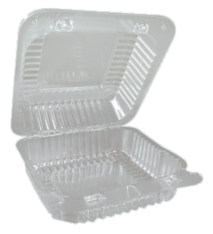
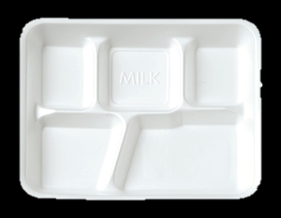
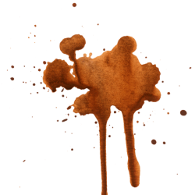
Day 4: Café Trays
Recycle | Trash | Dump
Clamshells, milk cartons, clean paper boats | Food, dirty paper boats, Styrofoam trays | liquids

Slide 8
Thank you for Recycling!

